Slide 1
Data Systems Research at CWI
Peter Boncz CWI + VU
all members of the Database Architectures group..
Notes:
My name is Peter Boncz and besides my part-time appointment as professor at VU University Amsterdam, I am a member of the management team of CWI, the Dutch national institute for computer science and mathematics research (birthplace of python and the internet-beyond-the-USA). I supervise three research groups: Machine Learning (led by Peter Grunwald), Human-Centered Data Analytics (led by Laura Hollink) and Database Architectures (led by Stefan Manegold). My background is the Database Architectures group and in this presentation I will give an overview of its activities.

Slide 2
Outline
Intro
Data systems research @ CWI DA
Past
MonetDB & VectorWise + impact
Present
DuckDB (“in-process analytics”)
Future
Learned Data Formats
SQL:2023 (Property Graph Queries)
Responsible Decentralized Data Architectures
Notes:
I will be talking about the past, present and future of this research

Slide 3
Data Systems Research
data systems: of the most complex software
10-100Ks of source code, takes 5-10y and 100sFTE
compression, data structures, algorithms, optimization, machine learning, compilers, operating systems, hardware co-design
Notes:
Data systems are of the most complex software that exists. Creating such software is a team effort and requires many person-years. There is no formula for an optimal systems architecture: it needs to balance conflicting interests. These interests change also, as applications change, but also hardware and software. Data systems architecture brings together techniques from many fields: data compression, data structures, efficient algorithms, problem optimization (e.g. finding good join orders), machine learning, compiler techniques, operating systems, software engineering and testing and hardware co-design.

Slide 4
Data Systems Research
data systems: of the most complex software
10-100Ks of source code, takes 5-10y and 100sFTE
compression, data structures, algorithms, optimization, machine learning, compilers, operating systems, hardware co-design
architecture = reconciling conflicting interests
writes⇔reads; size⇔computation; flexibility⇔efficiency; etc
Notes:
Though we tried to generate database systems automatically, this has failed so far to be fully automated (people are now trying with ML: learned data systems).. It requires balancing conflicting interests: design decisions that favor reads (like fancy indexes to find data fast) will slow down writes (as the index needs to be maintained under updates). Compression decreases data size and I/O, but increases CPU cost, etc. etc. etc.

Slide 5
Data Systems Research
data systems: of the most complex software
10-100Ks of source code, takes 5-10y and 100sFTE
compression, data structures, algorithms, optimization, machine learning, compilers, operating systems, hardware co-design
architecture = reconciling conflicting interests
writes⇔reads; datasize⇔computation; flexibility⇔efficiency; etc
systems research
PVLDB, SIGMOD, CIDR, ICDE, DaMoN
Turing Awards: Jim Gray, Michael Stonebraker
Notes:
Data systems design is a significant field of research. It produced Turing Award winners. Databases are a piece of almost any IT system.

Slide 6
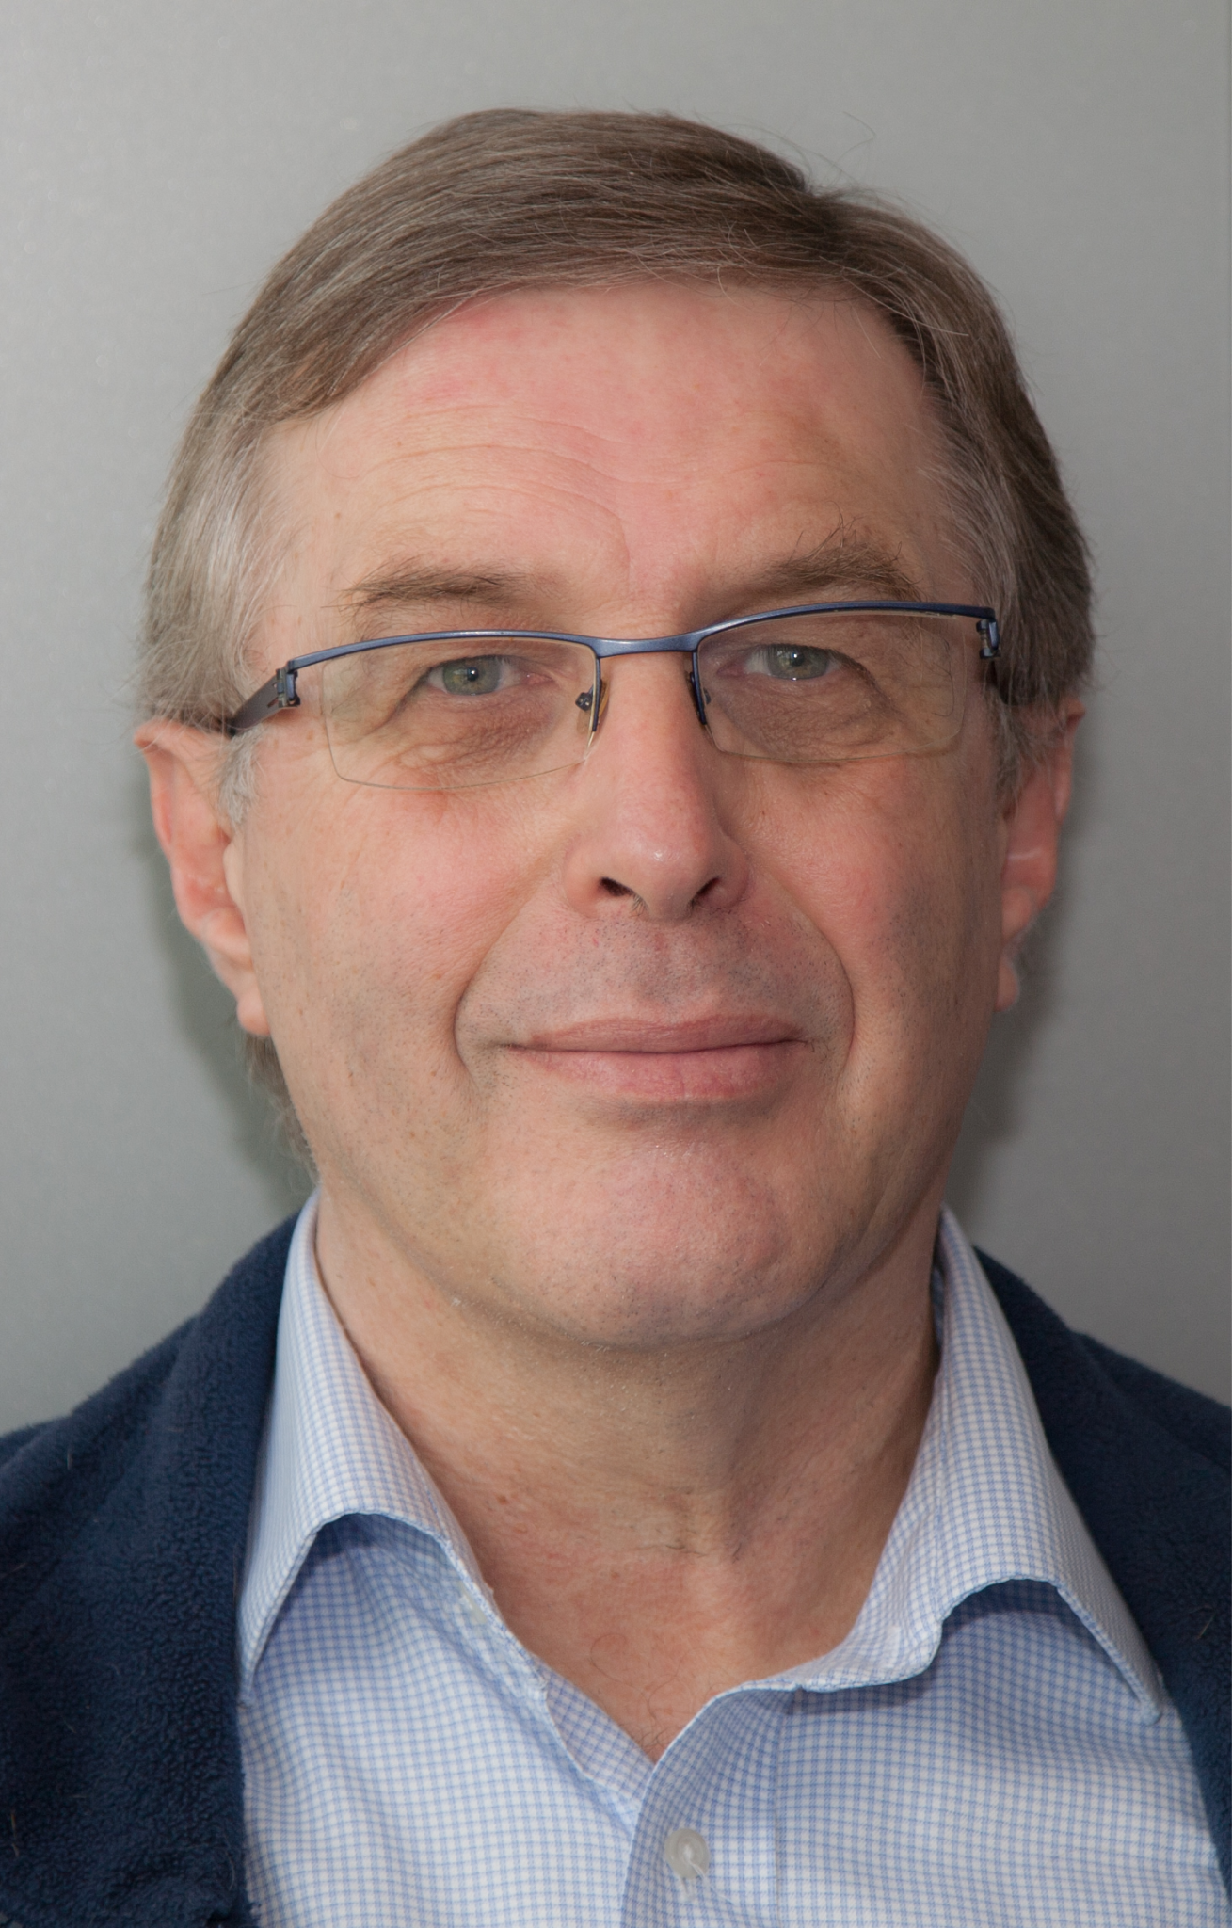
Data Systems Research at CWI
data systems: of the most complex software
10-100Ks of source code, takes 5-10y and 100sFTE
compression, data structures, algorithms, optimization, machine learning, compilers, operating systems, hardware co-design
architecture = reconciling conflicting interests
writes⇔reads; datasize⇔computation; flexibility⇔efficiency; etc
systems research
PVLDB, SIGMOD, CIDR, ICDE, DaMoN
Turing Awards: Jim Gray, Michael Stonebraker
Martin Kersten
Notes:
We do data systems research at CWI. Let me honor my mentor Martin Kersten, regrettably deceased way too early in 2022. He started the database research group at CWI in 1985. He won many awards. Not a Turing Award, but the ACM SIGMOD Contributions Award and the Systems Award (for MonetDB), he was named ACM Fellow. And he became a “database knight” ;-) - at his retirement he was granted a Dutch royal distinction. His creativity and counter-current thinking shall not be forgotten, his team focus on long-term software development shall live on.

Slide 7
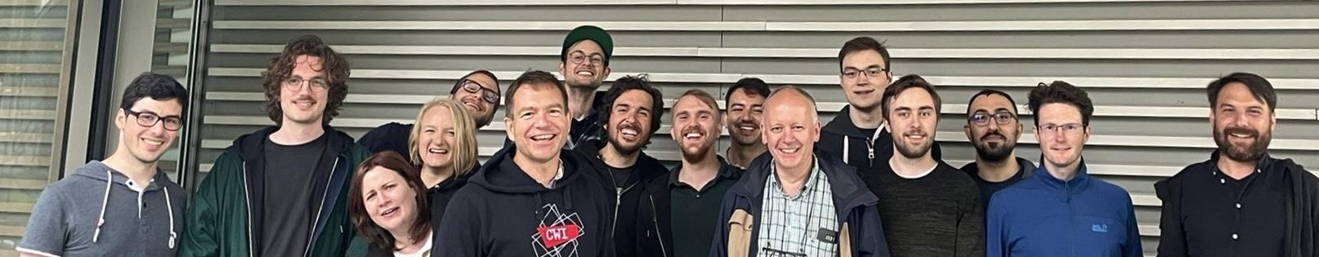
Data Systems Research at CWI
Database Architectures (now)
tenured: Peter Boncz, Stefan Manegold, Hannes Mühleisen
post-doc: Mark Raasveldt, Pedro Holanda, Gabor Szarnyas
PhD: Tim Gubner, Diego Tomé, Azim Afroozeh, Laurens Kuiper, Orson Peters, Ilaria Battiston + 7 interns + 2 startup employees
Notes:
This is the current Database Architectures research group at CWI plus the DuckDB Labs crew (our latest spin-off company).
Proud of the team! Maybe you should consider joining?

Slide 8
Outline
Intro
Data systems research @ CWI DA
Past
MonetDB & VectorWise + impact
Present
DuckDB (“in-process analytics”)
Future
Learned Data Formats
SQL:2023 (Property Graph Queries)
Responsible Decentralized Data Architectures
Notes:
Let us dive in the glorious past of the DA group ;-)

Slide 9
Main Memory Column Stores
Hardware Trends
Databases ⇒ Big Data
big memories ⇔ memory wall
Notes:
The CWI group is famous for pioneering column stores as the architecture and storage format for Big Data™. This was work done on MonetDB, i.e. my PhD thesis. Main memories grew big, but also became slow with respect to CPUs (GHz clock speeds made them fast). A memory cache hierarchy emerged. Not using this hierarchy well causes data intensive applications to hit a “memory performance wall”

Slide 10
Main Memory Column Stores
Hardware Trends
Databases ⇒ Big Data
big memories ⇔ memory wall
Conflict: analytics ⇔ transactions
Traditional RDBMS optimized for transactions
Research Question: database architecture for data mining?
Notes:
The research question behind my PhD was: if we would start with a clean sheet (in 1993) to design an analytical database system, what would it look like? Up until that time we had row-stores, with tuple-at-a-time Volcano query processing - systems like DB2, SQLserver, Oracle and Postgres. What did our clean sheet design look like?. It focused on optimizing memory access in sequential scans, and improving CPU efficiency in large aggregations and joins. This became MonetDB. Martin Kersten set the course, I investigated the forces at work to understand, explain and optimize its architecture.

Slide 11

Main Memory Column Stores
Hardware Trends
Databases ⇒ Big Data
big memories ⇔ memory wall
Conflict: analytics ⇔ transactions
Traditional RDBMS optimized for transactions
Research Question: database architecture for data mining?
Notes:
We realized there was a big demand for fast analytical systems. It was 1997 and there was a new analytical domain emerging: data mining, KDD was just formed from VLDB/SIGMOD. We created a data mining startup called Data Distilleries that embedded MonetDB as its analytical engine.

Slide 12

Main Memory Column Stores
Hardware Trends
Databases ⇒ Big Data
big memories ⇔ memory wall
Conflict: analytics ⇔ transactions
Traditional RDBMS optimized for transactions
Research Question: database architecture for data mining?
MonetDB (1994-) Martin Kersten, Niels Nes, Sjoerd Mullender, ..
column-at-a-time processing
CPU & cache-conscious algorithms
Notes:
The main idea of MonetDB is to reduce computational overhead in query processing using a simple column-algebra: simple inflexible column-at-a-time operators where inside everything is hardcoded (no interpretation). This brings out the best of array-optimizing compilers to create CPU-efficient loop code. MonetDB optimizes data access by using array layout (so you only touch the columns you need), and introduced refined algorithms that improve cache locality (e.g. radix-partitioned-hashjoin). It was teamwork, where I stood on the shoulders of Martin Kersten, Sjoerd Mullender and Niels Nes, among others.

Slide 13
Main Memory Column Stores
Hardware Trends
Databases ⇒ Big Data
big memories ⇔ memory wall
Conflict: analytics ⇔ transactions
Traditional RDBMS optimized for transactions
Research Question: database architecture for data mining?
MonetDB (1994-) Martin Kersten, Niels Nes, Sjoerd Mullender, ..
column-at-a-time processing
CPU & cache-conscious algorithms
Impact ⇒ SAP HANA (2010) + column store revolution (2005-)
Notes:
MonetDB had a large impact on industry. One of the first adopters was SAP, with their T-REX system that was inspired on MonetDB (it is now called HANA). MonetDB paved the way for the column-store revolution in analytics (later Stonebraker started C-store and Vertica). There is not a single analytical data systems technology now that is not columnar. We also created our own spin-offs around the open-source MonetDB technology.

Slide 14
Vectorized Query Processing
MonetDB scalability..
all operations materialize full table columns ⇒ “memory hungry”
what if data > memory?
Notes:
Though after my PhD I was quite full of MonetDB, it was a big shock when I discovered that its performance could still be improved by factors.
This happened when we compared MonetDB performance with a hand-written C++ program for TPC-H queries.
It turns out that column-at-a-time execution strategy is good for CPU, but bad for memory consumption. The memory hunger of MonetDB also gets problematic once Big Data exceeds RAM size (it sometimes does).

Slide 15

Vectorized Query Processing
MonetDB scalability..
all operations materialize full table columns ⇒ “memory hungry”
what if data > memory?
Idea: incremental column processing
manipulate small column slices (“vectors”) at the time
VectorWise system (2005-) Marcin Zukowski, Sándor Héman, ..
scaling beyond RAM (“cooperative scans”)
Notes:
So we set out to invent a query processing model that kept the low-interpretation-overhead array-processing of MonetDB, but did so on small column slices (we call those “vectors”) . This we baptized vectorized query execution. The name suggests the use of SIMD (vector instructions) and it is certainly good for those, but that is only one of its many strengths. It allows a query interpreter to be (almost) as fast as compiled code (or even faster, sometimes, when parallel memory access comes into play). It led to the VectorWise system, and yet another spinoff company.

Slide 16
Vectorized Query Processing
MonetDB scalability..
all operations materialize full table columns ⇒ “memory hungry”
what if data > memory?
Idea: incremental column processing
manipulate small column slices (“vectors”) at the time
VectorWise system (2005-) Marcin Żukowski, Sandor Heman, ..
scaling beyond RAM (“cooperative scans”)
Impact ⇒ Google Dremel (F1, BigQuery), Apache Drill, Apache Impala, Dremio, CockroachDB, Databricks Delta Engine, Microsoft SQLserver, IBM DB2 Blu, MySQL Heatwave (Oracle), ClickHouse, Snowflake, …, …, …,
Notes:
Vectorized query processing is a big hit now, and most modern analytical engines use it. Its only competition here is the data-centric code generation approach with Just-In-Time (JIT) compilation of queries to machine code, popularized by the Hyper system (now in Tableau). Vectorized query processing provides high performance, but unlike JIT systems can adaptively change a query plan during execution yet is still easy to debug, to profile, and to maintain. JIT systems need to include a compilation toolchain and queries suffer from compilation latency. This explains the wide adoption of vectorized query processing. Spark actually first went JIT but then switched to vectorized in their new Databricks Photon engine.

Slide 17
VectorWise Data Format
Compressed columnar storage
vector-at-a-time decoding algorithms
decompress small vectors into CPU cache
Run-Length, Zero Truncation (FOR), Delta coding, Bit-Packing
remove outliers (“patching”)
Notes:
VectorWise also set a new standard in data storage, where columnar storage is combined with lightweight encodings, such as Run Length Encoding (RLE), Dictionary compression, Frame of Reference (“zero truncation”) and null compaction (not storing NULLs, e.g. with a bitmap). Columns contain values from one distribution and tend to have lower entropy than row-stores, and thus compress better. VectorWise added patching to remove outliers and improve compression ratio. The large uncompressed data is only materialized as vectors, but these fit the CPU cache (vectorized execution makes decompression superfast).

Slide 18
VectorWise Data Format
Compressed columnar storage
vector-at-a-time decoding algorithms
decompress small vectors into CPU cache
Run-Length, Zero Truncation (FOR), Delta coding, Bit-Packing
remove outliers (“patching”)
Skippable Row-groups
= large table chunks with inside columnar storage (PAX)
Min/Max for each column in header ⇒ exploit natural orderings
Notes:
Vectorwise organized its data in large table slices where the column slices are stored together in one file (such a table slide is known as a “row-group”). This adopted a technique called PAX but at a large scale (many megabytes for a row-group). We combined this with MinMax statistics kept as metadata, cheaply kept on each column, that allow to skip row-groups that contain data that is not relevant to filtered queries.

Slide 19
VectorWise Data Format
Compressed columnar storage
Vectorizable encoding algorithms
decompress small vectors into CPU L1 cache
Run-Length, Zero Truncation (FOR), Delta coding, Bit-Packing
remove outliers (“patching”)
Skippable Row-groups
Columnar storage per large table chunk
Min/Max for each column in header ⇒ exploit natural orderings
Impact ⇒ Lucene, Dremel, ORC, Parquet (yottabytes)
Notes:
These ideas were again widely adopted. The lightweight compression for instance is in Lucene and Elastic. The columnar compression, row-groups and MinMax where adopted by the Google Dremel format and subsequently in ORC and Parquet. Most data in data lakes is now stored in Parquet. The volumes of data stored compactly with these ideas by now are in the yottabytes.

Slide 20

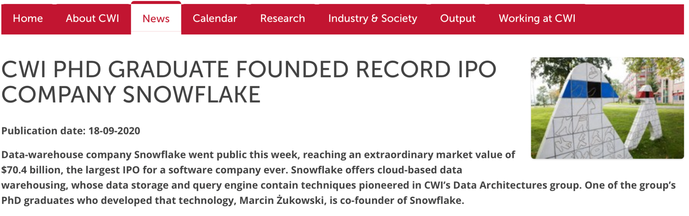
VectorWise ⇒
Notes:
VectorWise itself was acquired by Actian (it is simply called Vector now). That company has not executed very well, and my first PhD student, Marcin Zukowski, who was the VectorWise CEO moved on to co-found Snowflake - joining Benoit Dageville and Thierry Cruanes in 2014. This company’s breakthrough is the first cloud-native database architecture that properly separates compute and storage and is fully elastic. But it is also an efficient compressed column store with vectorized execution, and that was Marcin’s doing. The rest is history.. a record-setting IPO and a thriving company at the forefront of cloud based data services.

Slide 21
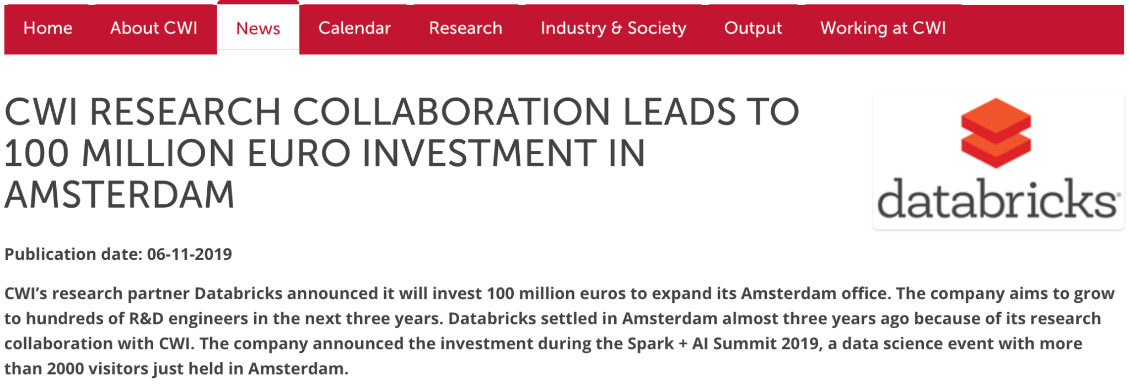
VectorWise ⇒ Databricks (Spark)
Notes:
Cynics might say, well great that some US investors got extremely rich, but you should not be giving this away. They don’t say that to scientists with less impact BTW. And I believe it is our foremost mission as scientists to have impact in ideas. Benefits follow indirectly, and more so if one is not paranoid and possessive. In fact, I negotiated a new home for my VectorWise team in 2017 and it became Databricks Amsterdam. This was the second R&D office after their San Francisco HQ, now employs more than 220. Databricks has invested >EUR 100M in the Dutch economy. Databricks is a company at the forefront of cloud-based data engineering and AI.

Slide 22




VectorWise ⇒ Databricks (Spark)
Notes:
It is my personal desire to create a data systems ecosystem in Europe and specifically in Amsterdam. I would like my PhD students to be able to find high-tech jobs there, without strictly requiring a move to Silicon Valley (as when I was young). By now Relational.ai, Oracle, Elastic, among others are in Amsterdam (and Booking, Uber and Tom Tom). Plus of course our own plucky DuckDB Labs.

Slide 23
Outline
Intro
Data systems research @ CWI DA
Past
MonetDB & VectorWise + impact
Present
DuckDB (“in-process analytics”)
Future
Learned Data Formats
SQL:2023 (Property Graph Queries)
Responsible Decentralized Data Architectures
Notes:
Let’s leave the past behind and take a look at what we are doing now at CWI.

Slide 24
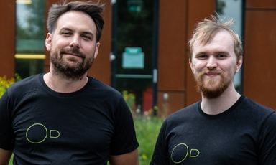


DuckDB: in-process analytics
Created by Hannes Mühleisen and Mark Raasveldt
Idea: analytical SQL system as a linkable library
From research on data systems support for data science
Notes:
My fabulous colleague Hannes Muehleisen with Mark Raasveldt has created DuckDB, the latest CWI database system. Its is purely open-source; and the main idea is to create an embeddable dana analytics system. They felt it a shame that after so many years and so many thousands of (delta) papers, there was no state-of-the-art open-source analytical database system. But now there is in DuckDB. Their initial focus was in data science: how to create a data system that helps data scientists? Why don’t they use databases??

Slide 25


DuckDB: in-process analytics
Created by Hannes Mühleisen and Mark Raasveldt
Idea: analytical SQL system as a linkable library
From research on data systems support for data science:
why don’t data scientists use database systems?
can transactions handle data science bulk-updates?
can we ensure reliability on cheap consumer hardware?
how to execute queries on compressed vector data?
scalable algorithms that respect changing/limited host resources?
…
Pedro Holanda
Laurens Kuiper
+ Ilaria Battiston
Notes:
Until DuckDB, data scientists would shun to use databases. But they use pandas and in R dplyr, which are data processing libraries. Hannes and Mark investigated why and started to work with data scientists to take away the barriers. Creating an embeddable database system also led to a string of new systems architecture research questions that we are still working on at CWI, in the context of DuckDB. The full history of DuckDB is in github, documenting how an analytical database system is constructed, tested and evolved.

Slide 26
DuckDB: in-process analytics
Created by Hannes Mühleisen and Mark Raasveldt
Idea: analytical SQL system as a linkable library
We foresee many applications beyond data science notebooks:
cloud analytics based on DuckDB
mobile apps that keep (most) data decentralized
edge analytics (e.g., intelligent streetlights, self-driving cars)
client-side (in-browser) query processing
computational storage (SQL in the disk drive)
secure enclave DBs
your research?
Notes:
DuckDB is a state-of-the-art system that combines the best ideas of VectorWise and HyPer, and adds some more of its own (like compressed execution and transactions optimized for data science operations that are bulky). All VCs we met want to build the next Snowflake with it, but it is attractive for many application areas. Its low-footprint and lack of dependencies allows it to run on small edge devices, be very portable and even run in web-assembly in your browser. Try the shell.duckdb.org link! DuckDB wants to conquer the world..

Slide 27
DuckDB taking flight
Hannes & Mark put very serious effort in this
Target non-academics also, e.g., data scientists
R, python user groups. Now “DuckCon” also.
Blog at duckdb.org (has more page views than cwi.nl ;-)
Getting to Hacker News front page, e.g. by tweeting
Results
200K downloads last month (PyPi + CRAN + ..)
5400+ github stars
40 venture capitalists calling
DuckDB Labs start-up, plans for scale-ups
Also: academic adoption for research prototypes (e.g. GrainDB, U Waterloo)
Notes:
What is the secret sauce behind the enormous impact of DuckDB?? 200K downloads per month, 5400+ github stars, multiple startups and VCs queuing up? Standing on the shoulders of giants (HyPer, Vectorwise) is one ingredient. Another is taking users very seriously and this means engaging also, and mainly, with the non-academic world. Like data scientists. Via user groups, but also using social media. We tweet about a new feature, then get on the front page of HackerNews and this leads to an avalanche of clicks on the DuckDB blog, our main tech dissemination channel, in addition to scientific papers.

Slide 28
Outline
Intro
Data systems research @ CWI DA
Past
MonetDB & VectorWise + impact
Present
DuckDB (“in-process analytics”)
Future
Learned Data Formats
SQL:2023 (Property Graph Queries)
Responsible Decentralized Data Architectures
Notes:
OK, now let’s take a short peek into the future!

Slide 29
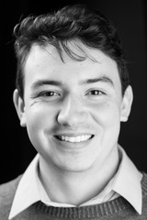
Learned Data Formats
Problem: data scientists/cloud-users store data inefficiently
Correlated columns, denormalized tables
Wrong datatypes (dates, numbers as string)
No key constraints specified
Idea: learn better ways of storing the data under the hood
Detect constraints and exploit them in queries
Store normalized, decorrelated data, in the best datatype
new low-level encodings optimized for SIMD/GPU/TPU (FastLanes)
Diego Tomé
Azim Afroozeh
Notes:
This project was previously called “white-box” compression; but we decided to abandon that term. In data storage, we see that a lot can be improved. Data scientists and cloud warehousing users are different from 1980’s DBAs and schemas are not carefully designed: these people make strange data type choices and define no constraints. Tables are not normalized but pre-joined and very redundant. We automatically learn from the data how to store it in a better shape. This is work by Diego Tome. Azim Afroozeh is looking at the low-level: the FastLanes redesigns columnar storage for modern parallel hardware (SIMD, GPUs and TPUs). We aso throw in our new random-access string compression scheme FSST

Slide 30

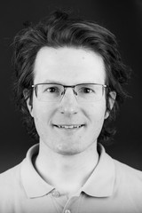
SQL/PGQ: Property Graph Query
https://ldbcouncil.org
ISO started working with LDBC on graph query languages
SQL:2023 will introduce PGQ:
Path-finding and pattern-matching
CREATE PROPERTY GRAPH pg
VERTEX TABLES (person PROPERTIES (personId, firstName))
EDGE TABLES (knows SOURCE person DESTINATION person PROPERTIES(creationDate))
)
Gábor Szárnyas
Notes:
In 2013 I directed a EU project called the Linked Data Benchmark Council (ldbcouncil.org). In 2016 it became a non-profit organization for standardization in the graph database space: RDF and property graph systems. It started with a focus on benchmarks, but later ventured into creating query languages and data models for property graphs. It created the G-CORE query language. After this, a liaison with ISO was formed. This resulted in the Property Graph Query (PGQ) extension of SQL:2023. ISO also works on a native graph query languages (GQL). The idea of PGQ is to “see graphs in relational data”: you name tables that contain vertexes and edges. These become a virtual property graph.

Slide 31
SQL/PGQ: Property Graph Query
https://ldbcouncil.org
ISO started working with LDBC on graph query languages
SQL:2023 will introduce PGQ:
Path-finding and pattern-matching
CREATE PROPERTY GRAPH pg (
VERTEX TABLES (person PROPERTIES (personId, firstName))
EDGE TABLES (knows SOURCE person DESTINATION person PROPERTIES(creationDate))
)
SELECT gt.src, gt.dst
FROM GRAPH_TABLE (pg, MATCH (p1 IS person)-[k IS knows]*->(p2 IS person)
WHERE k1.creationDate = 2022/06/01
COLUMNS (p1.name AS src, p2.name AS dst)) gt
Gábor Szárnyas
Notes:
Then, with SQL you query these graphs. The language allows to do pattern matching in cypher (neo4j) like syntax. It also allows for (shortest) path finding in these graphs. Here with kowns* i.e. the Kleene star. A graph query returns bindings (vertices or edges). For those you specify the columns (properties) you want returned and these become a temporary (graph) table result, that you can join with other tables in the FROM clause.

Slide 32
SQL/PGQ: Property Graph Query
CWI is working on a SQL/PGQ module for
Research Challenges:
vectorized pattern matching? (worst-case-optimal, factorized)
vectorized many–to-many path-finding algorithms
SQL/PGQ query optimization / statistics
In-process in-database GNN training on tabular PGs
Notes:
We are working to provide one of the first SQL:2023 implementations of PGQ in DuckDB. Gabor Szarnyas coordinates this at CWI.
For this, we are also going after a number of graph processing research questions. Modern systems must integrate worst-case-optimal join algorithms and factorized query processing techniques. These can also be helpful for relational queries. Same holds for query optimization.

Slide 33
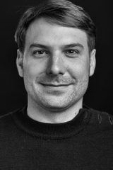
Responsible Distributed Data Architectures
VIDI grant 2022 by Hannes Mühleisen
Problem:
centralizing data in the cloud is dominant architecture
creates privacy nightmares
Goal:
provide an easy-to-use decentralized alternative
application data stays in a user-owned on-device database
design infra for managing large fleets of DuckDB databases
design infra for aggregated data collection to enable global queries
enable apps like distributed differential privacy, federated learning
Notes:
Currently application architectures are centralized, storing all data together (often in a cloud, now). This creates privacy nightmares. CWI wants to lead the way towards a more responsible database architecture where it is no longer standard to centralize all data. Users should have their data in their own small databases, under their own control (could also be in an embedded databases on a mobile device). We are trying to design infrastructure (the concept of distributed private tables and centralized incomplete aggregation tables) that will give application designers an easy way to decentralize most of their data. Of course, DuckDB is our main prototype environment. This is a prestigious Dutch research project just won by Hannes (comparable to an ERC consolidator).

Slide 34


CWI Database Architectures (DA)
Dutch Seminar on Data Systems Design (every other Friday 16:00-17:30)
subscribe: https://dsdsd.da.cwi.nl with UvA, TU/e, TuD
Dutch News on DA & DuckDB: @cwi_da bit.ly/cwi-da
bit.ly/fd-boncz (Financieel Dagblad) @duckdb duckdb.org
bit.ly/tweakers-duckdb (Tweakers) @hfmuehleisen duckdblabs.com
Thanks to all! Consider joining us!
Notes:
Thanks so much for your attention! In the picture you see again the current Database Architectures research group at CWI plus the DuckDB Labs crew. Proud of the team! Maybe you should consider joining? You can follow us on twitter.
For the Dutch-speakers there are two interviews linked here (FD about snowflake & databricks) and tweakers about DuckDB.
If you are interested in data systems research, consider registering for the DSDSD seminar; every other week on Friday.

